Slide 1
Player Signup and Deposit Analysis for Select Countries: Insights from July to September
Chidiebere Ogbuchi

Slide 2
Introduction
This presentation analyses a dataset of players who signed up between July and September from select countries (Canada, UK, Italy and New Zealand). The dataset includes unique player identifiers, signup dates, countries, currencies, and deposit activities.
It covers Signups Trend, Insights into the trends of First-Time Deposits (FTDs) as well as New Registrations Deposits Behaviour. These insights will help the Acquisition Manager enhance strategies for player onboarding and retention.

Slide 3



SIGNUPS
- Exploring new users creating an account on the platform

Slide 4
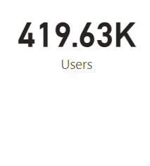
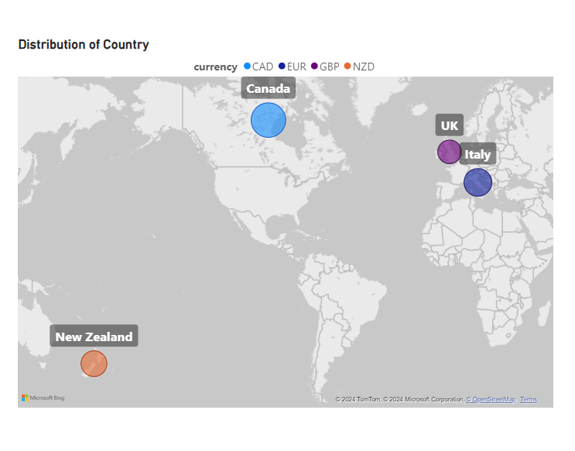
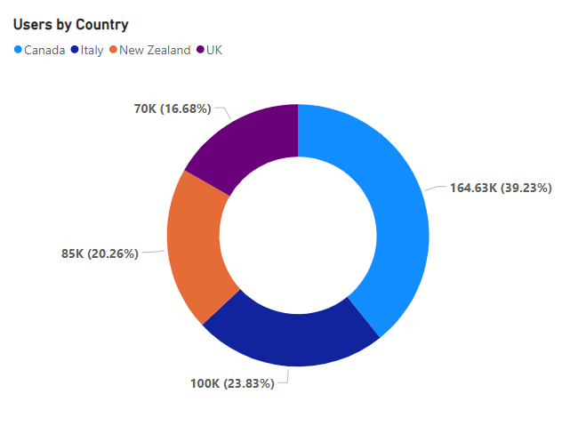
Signups Overview
The dataset recorded approximately 420,000 unique users across four countries. Canada had the highest number of users at 164,630, followed by Italy, New Zealand, and the UK. Users transacting in CAD accounted for 39.23% of the total.

Slide 5
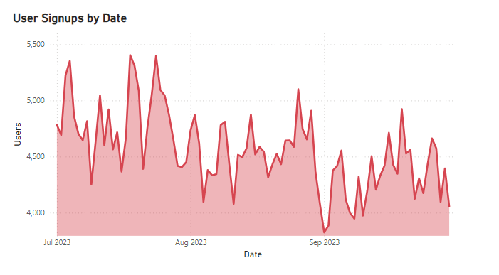
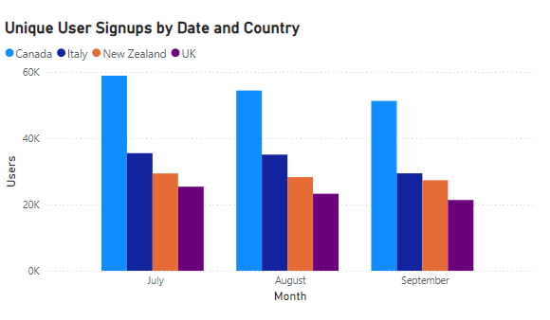
Signups Trend
User signups trended downward, with a 15% decrease from July 1 to September 30, reaching the lowest point on September 2. This decline was consistent across all countries, with Canada recording the highest number of monthly signups and the UK the fewest.
5
Notes:
﻿[]﻿﻿ ﻿﻿ ﻿﻿[]﻿﻿ ﻿﻿ ﻿﻿[]﻿﻿ ﻿﻿ ﻿﻿[]﻿﻿ ﻿﻿ ﻿﻿Users trended down, resulting in a 15.22% decrease between Saturday, July 1, 2023 and Saturday, September 30, 2023.﻿﻿ ﻿﻿ ﻿﻿Users started trending down on Tuesday, August 29, 2023, falling by 14.50% (712) in 13 days.﻿﻿ ﻿﻿ ﻿﻿[]﻿﻿ ﻿﻿ ﻿﻿Users jumped from 4,433 to 4,654 during its steepest incline between Tuesday, August 22, 2023 and Monday, August 28, 2023.﻿﻿ ﻿﻿ ﻿

Slide 6

First Time Deposits (FTDs)
- Initial deposit transactions made by new users after signing up

Slide 7
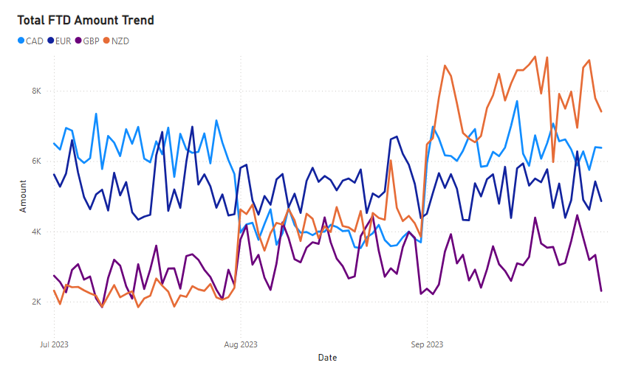
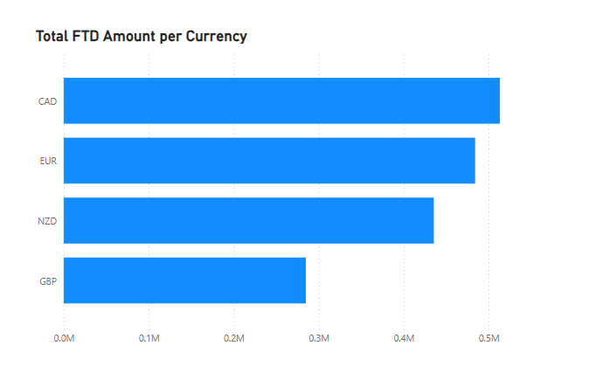
FTD Amount Trend
NZD showed an upward trend in first-time deposit (FTD) amounts, indicating that users who signed up in later months were depositing more as time progressed. In contrast, GBP and EUR deposit amounts remained relatively stable, while CAD saw a dip in August before recovering in September. Overall, across all four currencies, CAD recorded the highest deposit amounts, followed by EUR, NZD, and GBP.
Notes:
﻿[]﻿﻿ ﻿﻿ ﻿﻿The most recent Sum of deposit anomaly was on Monday, July 24, 2023, when EUR had a high of 6,979.50.﻿﻿ ﻿﻿ ﻿﻿Sum of deposit for CAD started trending up on Thursday, August 31, 2023, rising by 89.16% (3,290.50) in 2 days.﻿﻿ ﻿﻿ ﻿﻿[]﻿﻿ ﻿﻿ ﻿﻿At 513,289.60, CAD had the highest Sum of deposit and was 80.15% higher than GBP, which had the lowest Sum of deposit at 284,926.70.﻿﻿ ﻿﻿ ﻿﻿CAD had the highest Sum of deposit at 513,289.60, followed by EUR, NZD, and GBP.﻿﻿ ﻿﻿ ﻿﻿CAD accounted for 29.88% of Sum of deposit.﻿﻿ ﻿﻿ ﻿﻿Across all 4 currency, Sum of deposit ranged from 284,926.70 to 513,289.60.﻿﻿ ﻿﻿ ﻿

Slide 8
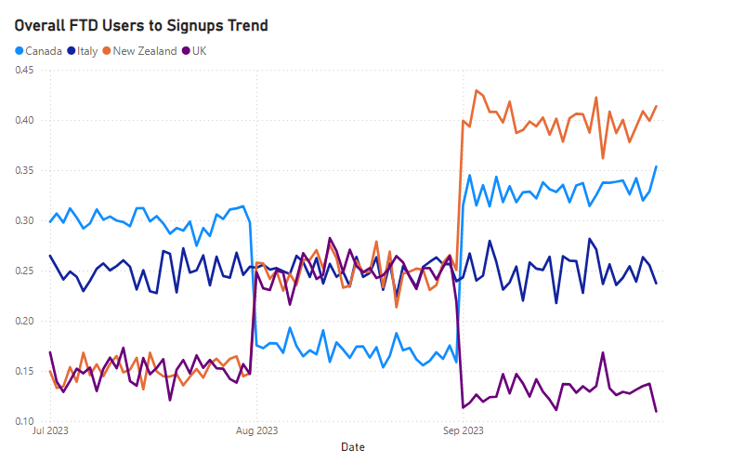
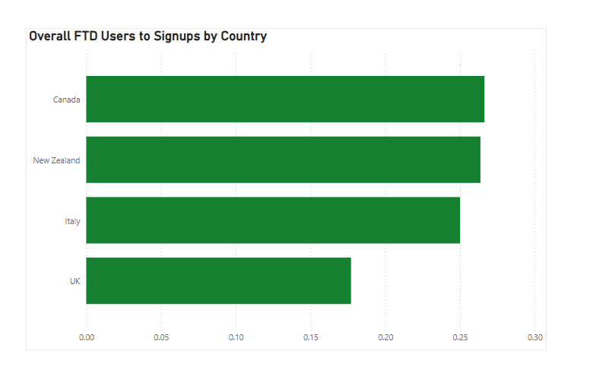
FTD Users to Signups Ratio – Conversion rate
In Canada, the ratio of FTD users to signups declined in August but rose again in September. Meanwhile, New Zealand recorded a steady increase in this ratio month over month. Canada had the highest overall FTD-to-signups ratio at 0.27, indicating that a significant percentage of new users were converting to depositors after signing up, reflecting strong user intent.

Slide 9
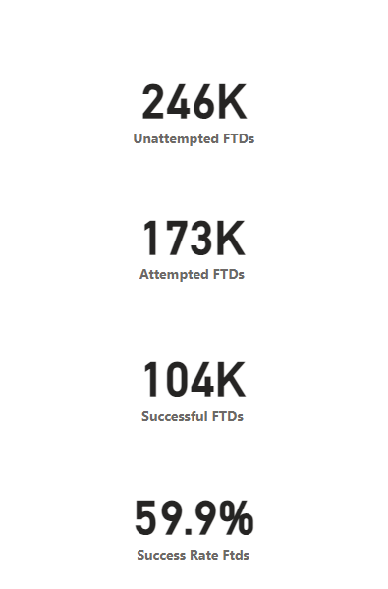
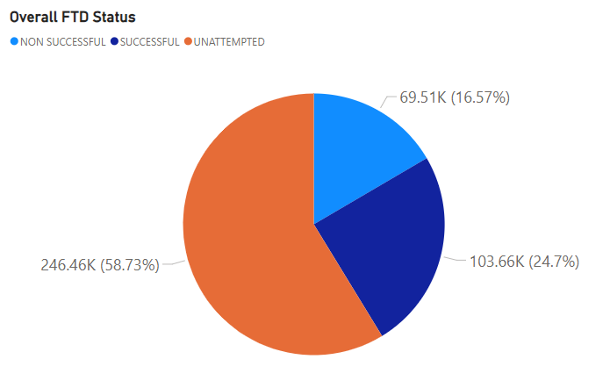
FTD Users’ Attempt
A high number of deposit attempts typically signals strong user interest; however, approximately 246,000 users did not attempt to make a FTD. Among the remaining 173,000 users who initiated a transaction, only about 59.9% of these first-time deposits were successful, indicating a relatively low conversion rate.
Notes:
﻿UNATTEMPTED had the highest Count of userID at 246,455, followed by SUCCESSFUL at 103,662 and NON SUCCESSFUL at 69,513.﻿﻿ ﻿﻿ ﻿

Slide 10
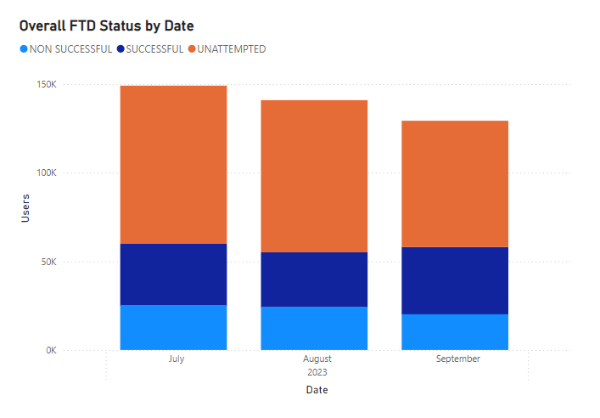
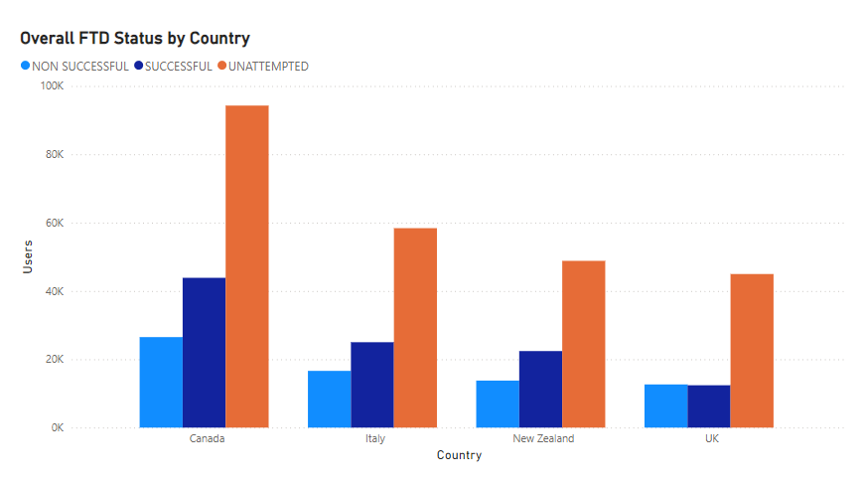
FTD Status Breakdown
In July, users who signed up made the most deposit attempts, resulting in approximately 35,000 successful first-time deposits. Among those who did not attempt any deposits after signing up, 95,000 were located in Canada. Additionally, between the months, successful FTDs saw the largest increase at 9.27%, while unattempted deposits had the largest decrease at 20.16%, indicating a slight improvement in the conversion rate.
Notes:
﻿UNATTEMPTED had the highest total Count of userID at 246,455, followed by SUCCESSFUL at 103662 and NON SUCCESSFUL at 69513.﻿﻿ ﻿﻿ ﻿﻿Canada in deposit_status UNATTEMPTED made up 22.47% of Count of userID.﻿﻿ ﻿﻿ ﻿﻿UNATTEMPTED had the highest average Count of userID at 61,613.75, followed by SUCCESSFUL at 25,915.50 and NON SUCCESSFUL at 17,378.25.﻿﻿ ﻿﻿ ﻿﻿[]﻿﻿ ﻿﻿ ﻿﻿Between July 2023 and September 2023, SUCCESSFUL had the largest increase in Count of userID (9.27%) while UNATTEMPTED had the largest decrease (20.16%).﻿﻿ ﻿﻿ ﻿﻿[]﻿﻿ ﻿﻿ ﻿﻿Across deposit_status, SUCCESSFUL had the most interesting recent trend and started trending up on July 2023, rising by 9.27% (3,223) in 2 months.﻿﻿ ﻿﻿ ﻿﻿[]﻿﻿ ﻿﻿ ﻿

Slide 11
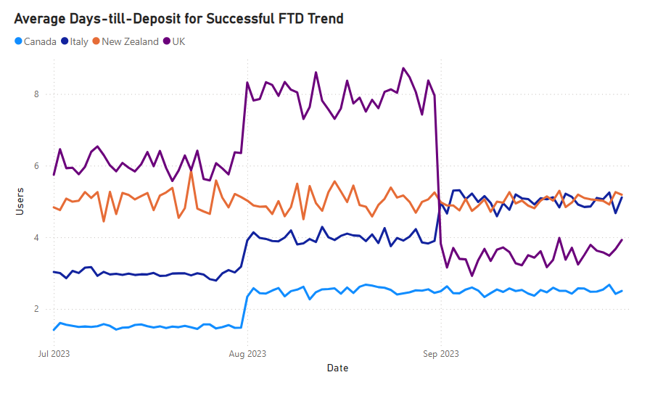
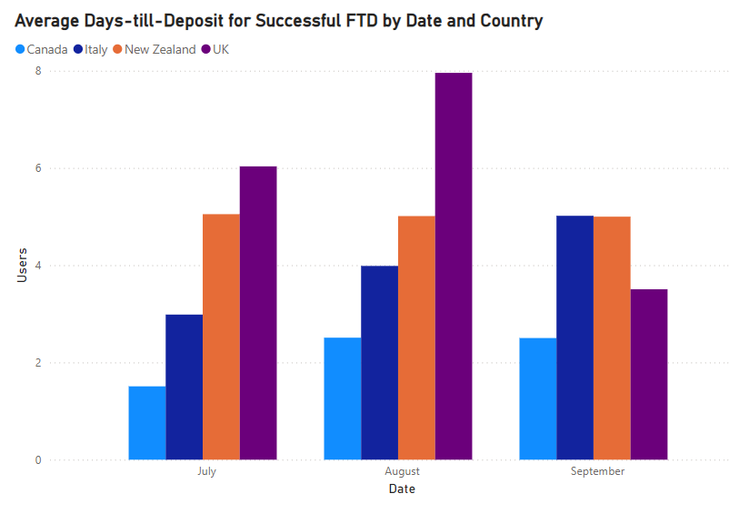
FTD Days till Deposit – Conversion Rate Time
A quick snapshot of the time it takes for new users to convert into depositors reveals that users in Canada took the fewest days across all months. In contrast, users in the UK had the longest average time from July to August, but this duration decreased in September. Meanwhile, New Zealand maintained a relatively stable conversion timeline throughout the period.
Notes:
﻿[]﻿﻿ ﻿﻿ ﻿﻿[]﻿﻿ ﻿﻿ ﻿﻿Average of days_till_deposit for New Zealand started trending up on Saturday, September 2, 2023, rising by 6.16% (.30) in 28 days.﻿﻿ ﻿﻿ ﻿﻿[]﻿﻿ ﻿﻿ ﻿﻿August in country UK made up 15.58% of Average of days_till_deposit.﻿﻿ ﻿﻿ ﻿﻿UK had the highest average Average of days_till_deposit at 5.83, followed by New Zealand, Italy, and Canada.﻿﻿ ﻿﻿ ﻿﻿[]﻿﻿ ﻿﻿ ﻿

Slide 12
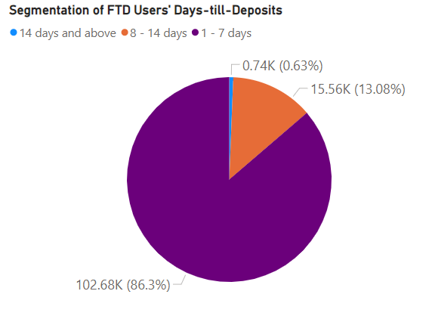
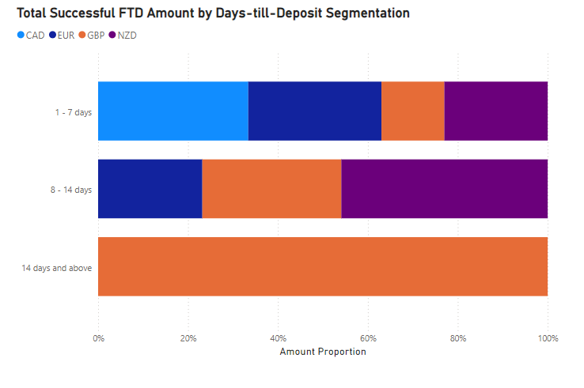
FTD User Segmentation by Days-till-Deposit
Grouping first-time depositors by the number of days taken to make their first deposit after signing up reveals that most users complete their first deposit within 1 to 7 days. Notably, Canada had the highest number of immediate depositors, indicating strong user intent or effective incentives, while the UK had the highest proportion of delayed depositors.
Depositors Key:
1-7 days – Immediate
8 -14 – Moderate
14 days and above - Delayed
Notes:
﻿1 - 7 days had the highest Count of userID at 102,684, followed by 8 - 14 days at 15,561 and 14 days and above at 744.﻿﻿ ﻿﻿ ﻿﻿1 - 7 days accounted for 86.30% of Count of userID.﻿﻿ ﻿﻿ ﻿﻿EUR had the highest total Sum of deposit at 433,873.80, followed by NZD at 406,050.70 and GBP at 266,429.70.﻿﻿ ﻿﻿ ﻿﻿1 - 7 days in currency CAD made up 27.70% of Sum of deposit.﻿﻿ ﻿﻿ ﻿﻿EUR had the highest average Sum of deposit at 216,936.90, followed by NZD at 203,025.35 and GBP at 88,809.90.﻿﻿ ﻿﻿ ﻿﻿[]﻿﻿ ﻿﻿ ﻿

Slide 13
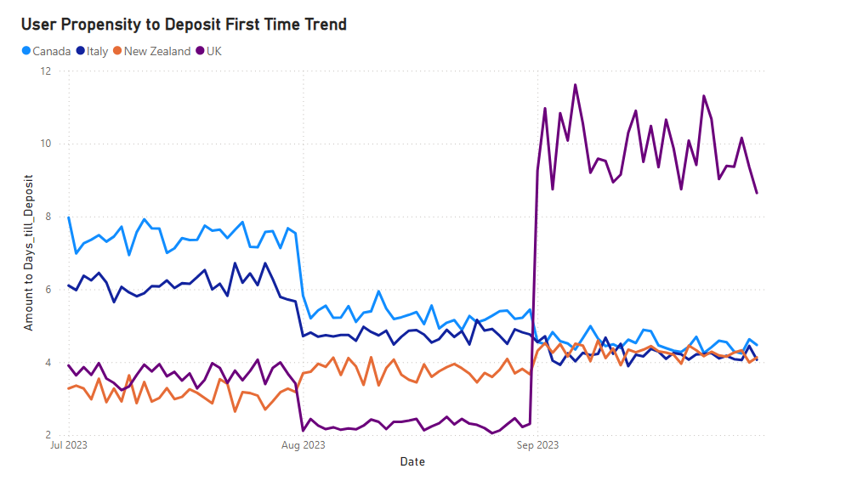
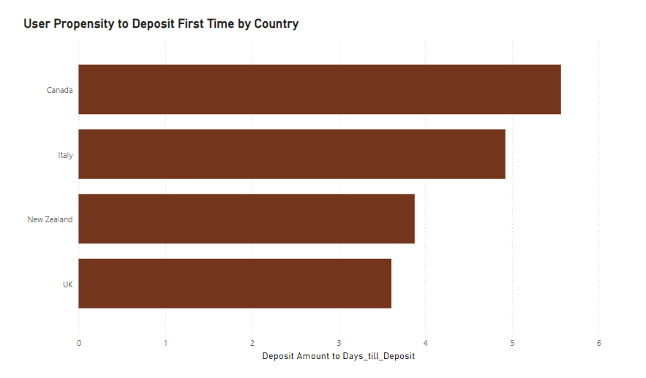
FTD Amount to Days till Deposit - User Propensity
The willingness of users to make quick first-time deposits indicates that the groups of signups in Canada and Italy were more inclined to deposit in July compared to other months. However, in September, the cohort of users in the UK saw a significant increase in first-time deposits, highlighting a greater commitment from these users to make their initial deposits.
Notes:
﻿Between Saturday, July 1, 2023 and Saturday, September 30, 2023, UK had the largest increase in Deposit_to_Days_Ratio_FTD (121.19%) while Canada had the largest decrease (43.85%).﻿﻿ ﻿﻿ ﻿﻿The most recent Deposit_to_Days_Ratio_FTD anomaly was on Saturday, September 2, 2023, when UK had a high of 10.97.﻿﻿ ﻿﻿ ﻿﻿Deposit_to_Days_Ratio_FTD for UK started trending down on Tuesday, September 26, 2023, falling by 7.94% (0.75) in 4 days.﻿﻿ ﻿﻿ ﻿﻿[]﻿﻿ ﻿﻿ ﻿﻿At 5.57, Canada had the highest Deposit_to_Days_Ratio_FTD and was 54.21% higher than UK, which had the lowest Deposit_to_Days_Ratio_FTD at 3.61.﻿﻿ ﻿﻿ ﻿﻿Canada had the highest Deposit_to_Days_Ratio_FTD at 5.57, followed by Italy, New Zealand, and UK.﻿﻿ ﻿﻿ ﻿﻿Across all 4 country, Deposit_to_Days_Ratio_FTD ranged from 3.61 to 5.57.﻿﻿ ﻿﻿ ﻿

Slide 14
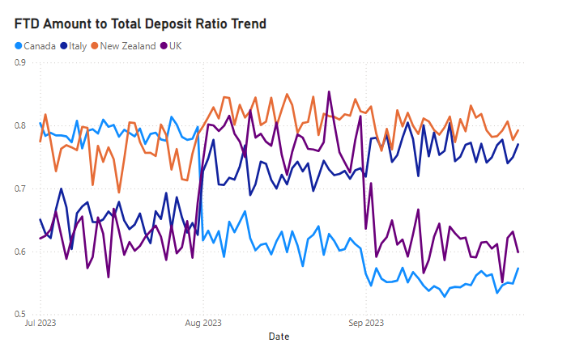
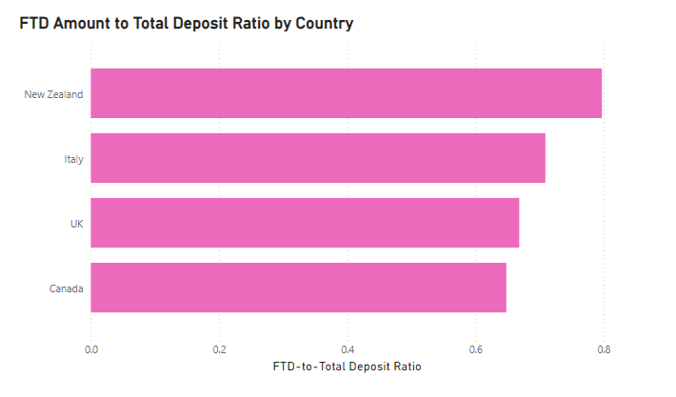
FTD Amount to Total Deposit Ratio – Lifetime Value rate
From July to September, Italy experienced the largest increase in the FTD to total deposit ratio at 18.38%, while Canada saw the largest decrease at 28.72%. These varying trends indicate that the FTD amount constitutes a significant portion of the total deposits, suggesting that users make a substantial financial commitment initially but may not continue to deposit as much afterward. This ideally reflects the levels of initial interest among users.
Notes:
﻿Between Saturday, July 1, 2023 and Saturday, September 30, 2023, Italy had the largest increase in FTD_to_Total_Deposit_Ratio (18.38%) while Canada had the largest decrease (28.72%).﻿﻿ ﻿﻿ ﻿﻿[]﻿﻿ ﻿﻿ ﻿﻿FTD_to_Total_Deposit_Ratio for UK started trending down on Tuesday, September 5, 2023, falling by 0.21% (0.00) in 23 days.﻿﻿ ﻿﻿ ﻿﻿[]﻿﻿ ﻿﻿ ﻿﻿At 0.80, New Zealand had the highest FTD_to_Total_Deposit_Ratio and was 23.03% higher than Canada, which had the lowest FTD_to_Total_Deposit_Ratio at 0.65.﻿﻿ ﻿﻿ ﻿﻿New Zealand had the highest FTD_to_Total_Deposit_Ratio at 0.80, followed by Italy, UK, and Canada.﻿﻿ ﻿﻿ ﻿﻿Across all 4 country, FTD_to_Total_Deposit_Ratio ranged from 0.65 to 0.80.﻿﻿ ﻿﻿ ﻿

Slide 15

New Registrations Deposits Behaviour
- patterns and trends in how newly registered users make deposits after signing up.

Slide 16
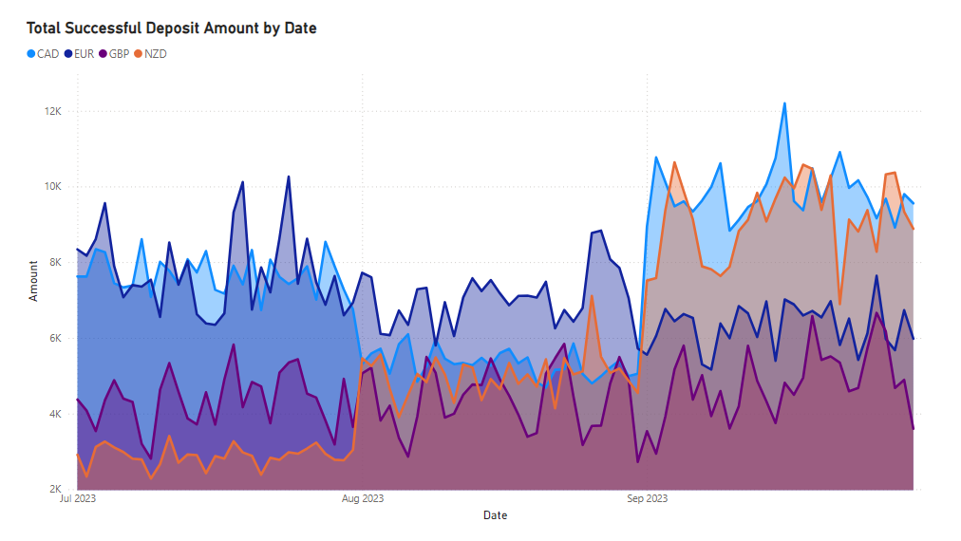
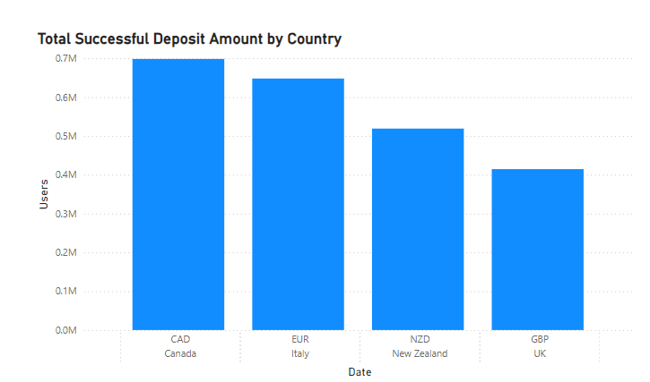
Total Deposit Trend
The total deposit trend tracks the overall deposit volume over time, providing insights into the effectiveness of user acquisition and retention efforts. Between July and September, NZD saw the largest increase; however, the majority of successful deposit amounts were recorded in CAD.
Notes:
﻿Between Saturday, July 1, 2023 and Saturday, September 30, 2023, NZD had the largest increase in Sum of deposit (204.86%) while EUR had the largest decrease (28.29%).﻿﻿ ﻿﻿ ﻿﻿The most recent Sum of deposit anomaly was on Thursday, August 31, 2023, when GBP had a low of 2,723.80.﻿﻿ ﻿﻿ ﻿﻿Sum of deposit for CAD started trending down on Sunday, September 24, 2023, falling by 6.01% (610.60) in 6 days.﻿﻿ ﻿﻿ ﻿﻿Sum of deposit for currency CAD was trending up between Sunday, September 3, 2023 and Friday, September 22, 2023 with a rise of 790.50 but had a significant change in trend and dropped by 610.60 starting Sunday, September 24, 2023.﻿﻿ ﻿﻿ ﻿﻿[]﻿﻿ ﻿﻿ ﻿﻿Canada in currency CAD made up 30.63% of Sum of deposit.﻿﻿ ﻿﻿ ﻿﻿[]﻿﻿ ﻿﻿ ﻿﻿[]﻿﻿ ﻿﻿ ﻿

Slide 17
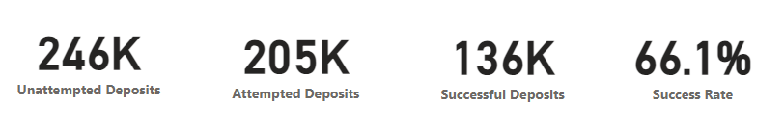
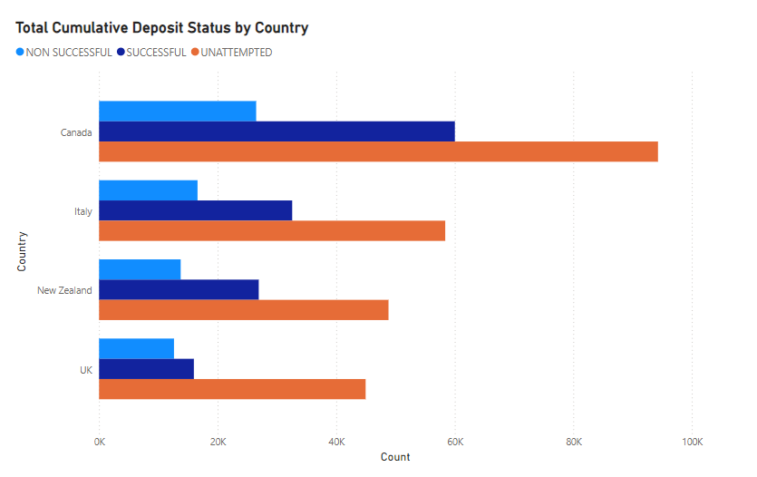
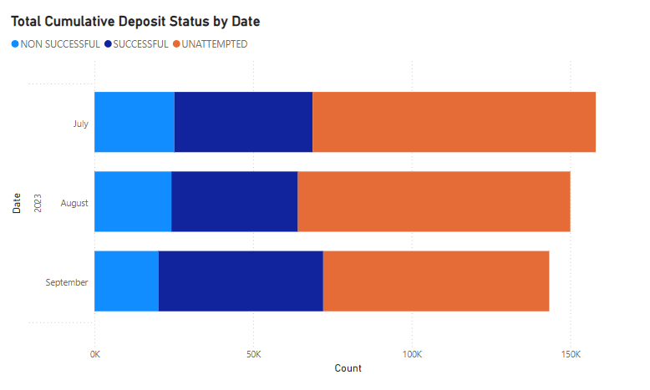
Deposit Frequency Status – User Activeness
September witnessed the highest number of users attempting a deposit. Overall, approximately 66.1% of attempted deposits were successful, with the majority of attempts coming from Canada. Additionally, Canada contributed the most to unattempted deposits, while the UK had the fewest. This behavior indicates the frequency with which users made deposits over the specified period.
Notes:
﻿UNATTEMPTED had the highest total Count of userID at 246,455, followed by SUCCESSFUL at 135513 and NON SUCCESSFUL at 69513.﻿﻿ ﻿﻿ ﻿﻿Canada in deposit_status UNATTEMPTED made up 20.88% of Count of userID.﻿﻿ ﻿﻿ ﻿﻿UNATTEMPTED had the highest average Count of userID at 61,613.75, followed by SUCCESSFUL at 33,878.25 and NON SUCCESSFUL at 17,378.25.﻿﻿ ﻿﻿ ﻿﻿[]﻿﻿ ﻿﻿ ﻿﻿Between July 2023 and September 2023, SUCCESSFUL had the largest increase in Count of userID (19.14%) while UNATTEMPTED had the largest decrease (20.16%).﻿﻿ ﻿﻿ ﻿﻿[]﻿﻿ ﻿﻿ ﻿﻿Across deposit_status, SUCCESSFUL had the most interesting recent trend and started trending up on July 2023, rising by 19.14% (8,352) in 2 months.﻿﻿ ﻿

Slide 18
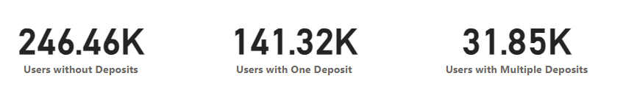
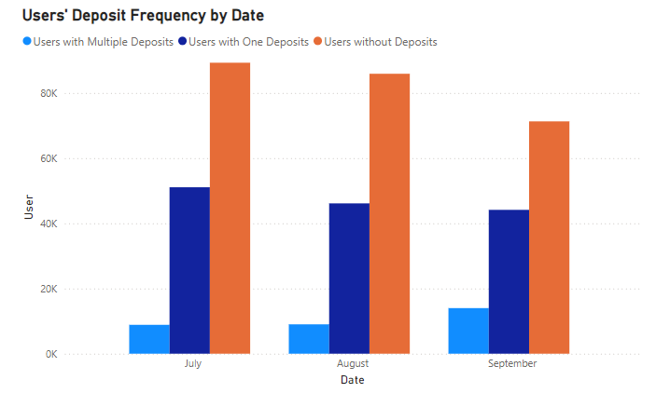
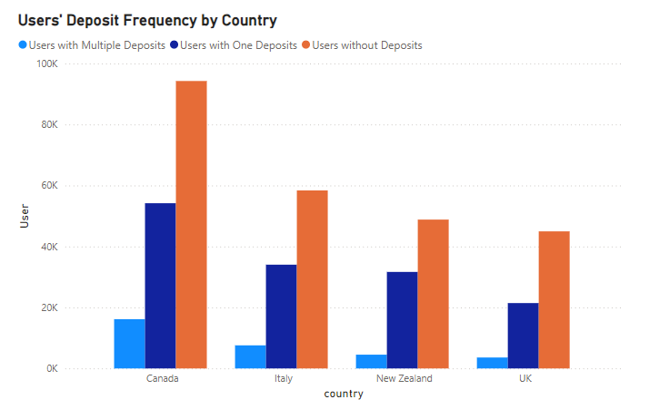
Retention & Deposit Recurrence
Nearly 32,000 users made multiple deposits after signing up, with about 44% of these users registering in July and only 28% each in August and September. Among these occasional depositors, users in the UK contributed the least amount, indicating low retention and spending power.

Slide 19
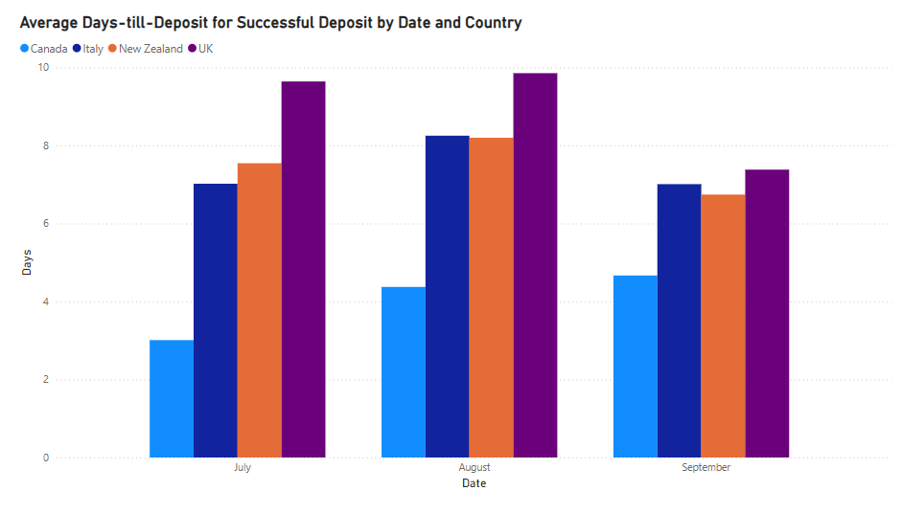
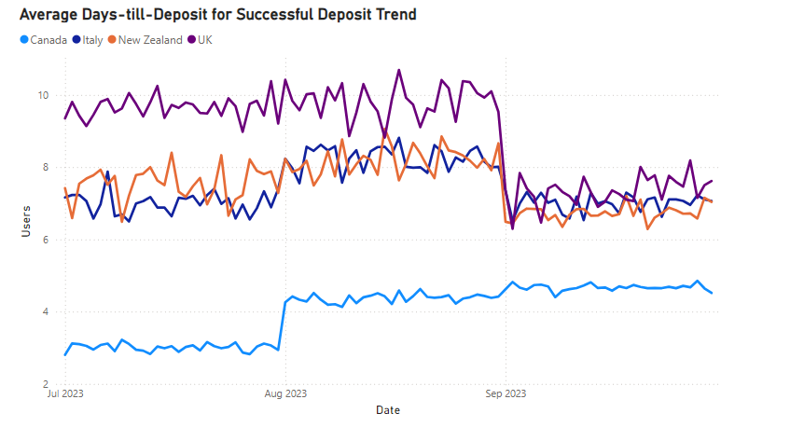
Overall Days till Deposit
Taking a holistic view of the typical time new users need before they commit financially, the UK had the highest average days to deposit at 8.96, followed by New Zealand, Italy, and Canada. This trend provides valuable insights into users' depositing patterns.
Notes:
﻿[]﻿﻿ ﻿﻿ ﻿﻿[]﻿﻿ ﻿﻿ ﻿﻿Average of days_till_deposit for UK started trending up on Monday, September 18, 2023, rising by 7.27% (.52) in 12 days.﻿﻿ ﻿﻿ ﻿﻿[]﻿﻿ ﻿﻿ ﻿﻿August in country UK made up 11.78% of Average of days_till_deposit.﻿﻿ ﻿﻿ ﻿﻿UK had the highest average Average of days_till_deposit at 8.96, followed by New Zealand, Italy, and Canada.﻿﻿ ﻿﻿ ﻿﻿[]﻿﻿ ﻿﻿ ﻿

Slide 20
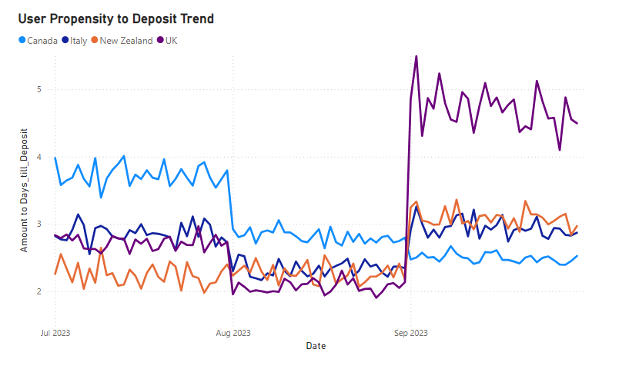
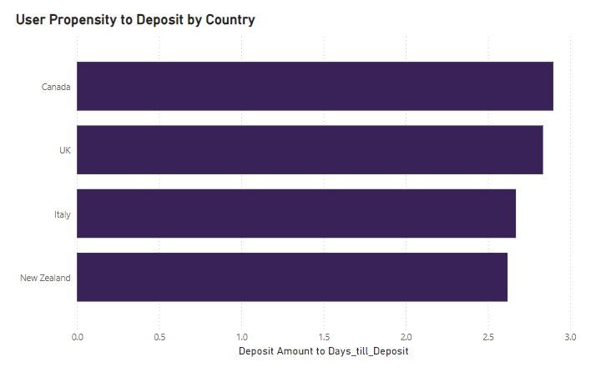
Overall User Propensity to Deposit
Compared to the user propensity to deposit first time, users in Canada had the highest deposit amount to days until deposit ratio at 2.90, followed by the UK, Italy, and New Zealand. Additionally, cohorts of users in the UK showed a significant increase in propensity to deposit in September, reflecting a higher level of commitment and engagement compared to previous months.
Notes:
﻿[]﻿﻿ ﻿﻿ ﻿﻿The most recent Deposit_to_Days_Ratio anomaly was on Saturday, September 2, 2023, when UK had a high of 5.49.﻿﻿ ﻿﻿ ﻿﻿Deposit_to_Days_Ratio for Italy started trending down on Wednesday, September 20, 2023, falling by 2.39% (0.07) in 10 days.﻿﻿ ﻿﻿ ﻿﻿[]﻿﻿ ﻿﻿ ﻿﻿At 2.90, Canada had the highest Deposit Amount to Days_till_Deposit and was 10.62% higher than New Zealand, which had the lowest Deposit Amount to Days_till_Deposit at 2.62.﻿﻿ ﻿﻿ ﻿﻿Canada had the highest Deposit Amount to Days_till_Deposit at 2.90, followed by UK, Italy, and New Zealand.﻿﻿ ﻿﻿ ﻿﻿Across all 4 country, Deposit Amount to Days_till_Deposit ranged from 2.62 to 2.90.﻿﻿ ﻿﻿ ﻿

Slide 21
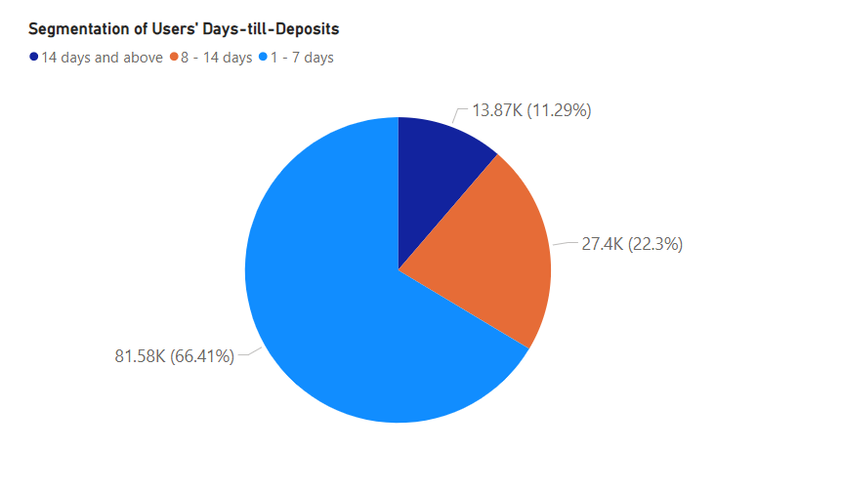
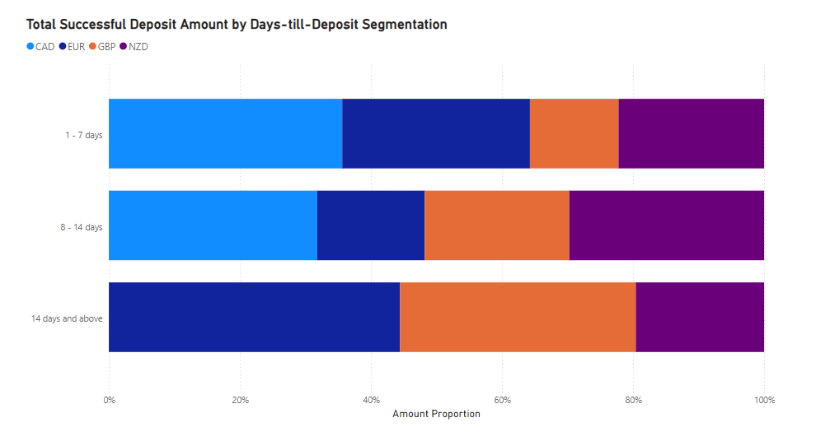
Overall User Segmentation by Days-till-Deposit
Generally, about 66% of deposits occurred within the first 7 days, while 11% were made after 14 days. Notably, no deposits from Canada were made after 14 days of signing up, whereas the majority of deposits in Italy and the UK occurred after this period. This suggests a need to enhance acquisition and retention efforts in these countries.
Depositors Key:
1-7 days – Immediate
8 -14 – Moderate
14 days and above - Delayed
Notes:
﻿1 - 7 days had the highest Count of userID at 81,581, followed by 8 - 14 days at 27,397 and 14 days and above at 13,870.﻿﻿ ﻿﻿ ﻿﻿1 - 7 days accounted for 66.41% of Count of userID.﻿﻿ ﻿﻿ ﻿﻿CAD had the highest total Sum of deposit at 609,090.50, followed by EUR, NZD, and GBP.﻿﻿ ﻿﻿ ﻿﻿1 - 7 days in currency CAD made up 22.36% of Sum of deposit.﻿﻿ ﻿﻿ ﻿﻿CAD had the highest average Sum of deposit at 304,545.25, followed by EUR, NZD, and GBP.﻿﻿ ﻿﻿ ﻿﻿[]﻿﻿ ﻿﻿ ﻿

Slide 22



SUMMARY
SIGNUPS
USER ACTIVITIES
KPI METRICS
Approximately 420,000 unique users registered.
Sign up declined month on month for all countries.
Canada had the highest amount of users and FTDs.
173,000 users attempted a FTD with only 59.9% being successful.
About 32,000 users made subsequent deposit after their FTD.
About 66% of the overall successful deposits were made between 1-7 days.
Users in Canada had the highest conversion rate and propensity to deposit.
New Zealand had the best FTD life time value rate.
Conversely, the UK had the lowest conversion rate; however, its propensity to deposit had the highest increase in September.

Slide 23




Areas of Actionable Insights
Enhancing user acquisition to stream-line the signup process and offer welcome promotions to encourage immediate deposits in low FTD countries like UK
Target segmentation of users based on depositing time behaviour to effectively improve conversion rate and propensity to deposit.
Retention Initiatives such as implementing loyalty programs to foster repeat deposits and increase deposit frequency and lifetime value rate.

Slide 24
“Business opportunities are like buses. There’s always another one coming.”
Richard Branson

Slide 25

Thank you

